Slide 1


Capstone Project
Developed By:
Aprajita Thakur
Reetika Pahuja
Aditya Ghodgaonkar
Supervised
By:
Mr. Anil Vashisht
Notes:
This slide contains the editable pieces that were used to build infographic sample
Icons – Eye, PC

Slide 2
Introduction
Unemployment in India is projected to increase from
Targeting Unemployment is the basic functionality of our project – Internhub.
17.7 million
From
last year
to
17.8 million
in 2017
18 million
Next year

Slide 3





Background of Project
Employer Posts Internship on Internhub
Students can browse Internships without creating an Account.
Students further submit their details and Resume directly to the employer using internhub.
If the employer finds the student’s application worthy he can shortlist him for internship.
22%

Slide 4
Scope and Utility
The Utility of this project is to design and develop an Internship portal, on which End users can search Internships & apply online for a specific Internship.
Companies can also post their Internships to hire interns for their company.
This portal will be specified only for Internships. Online business on this portal is beyond the scope of this project.
Internship seekers can search and apply online for Internships related to their fields with area specifications.

Slide 5




Architecture of the Project
Browser
PHP SCRIPTS
+
WEB
SERVER
(APACHE)
MySQL Database
PRESENTATION LAYER
APPLICATION LAYER
PERSISTANCE LAYER
TYPE: 3 Tier Architecture

Slide 6



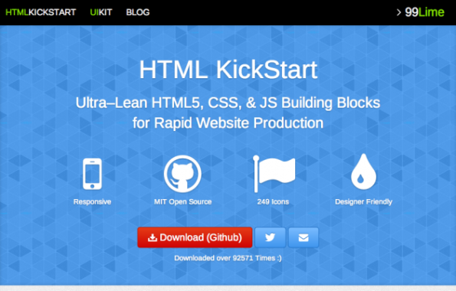
Techniques and Tools Used
WAMP STACK
PHOTOSHOP
CHROME
ATOM IDE +
KICKSTART HTML

Slide 7
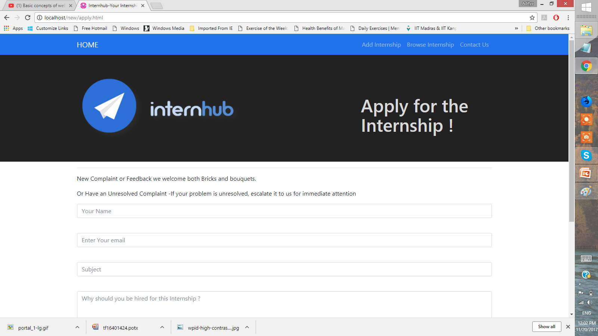
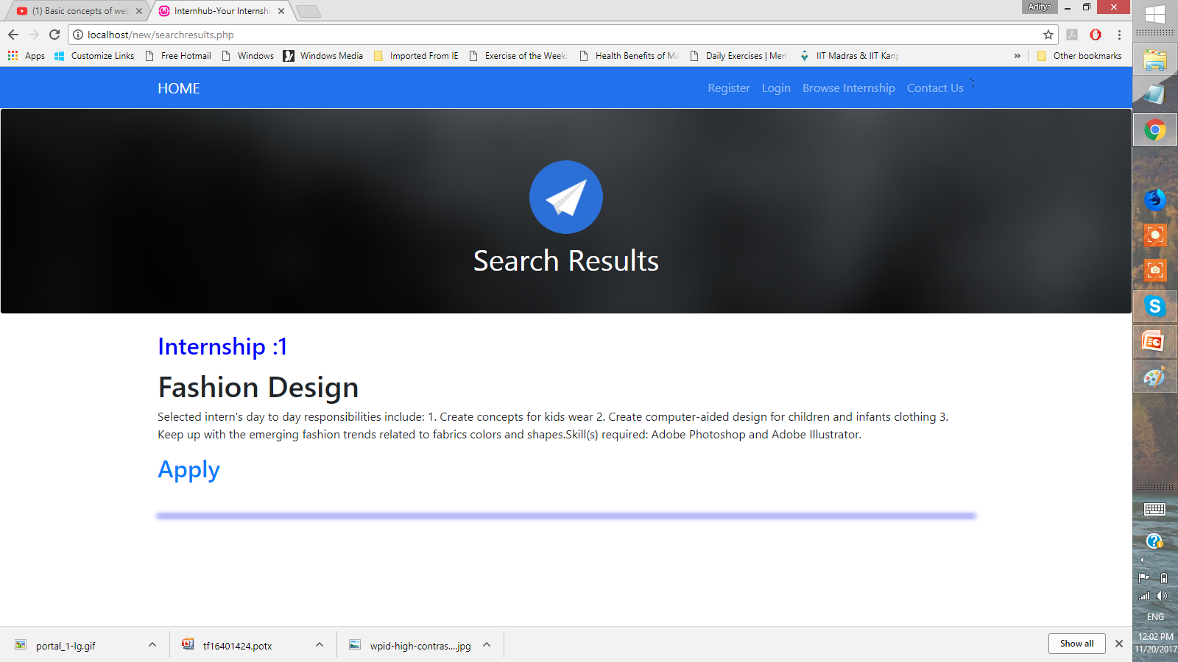
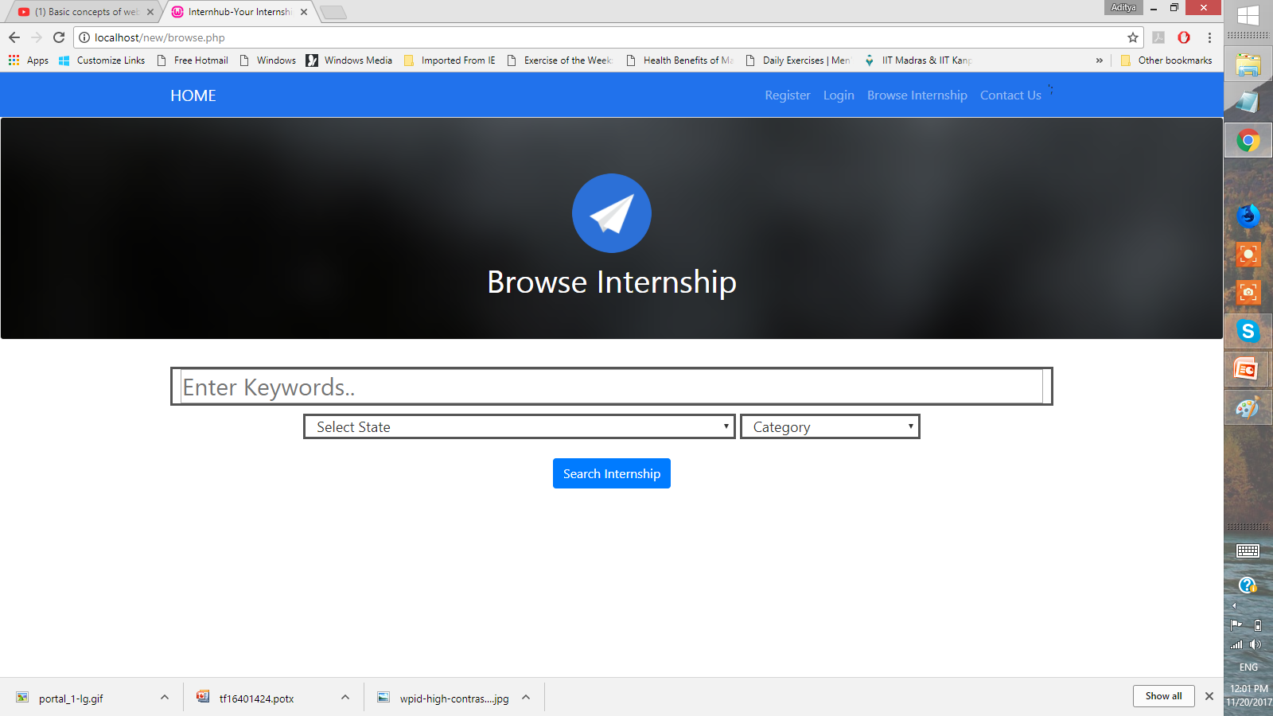
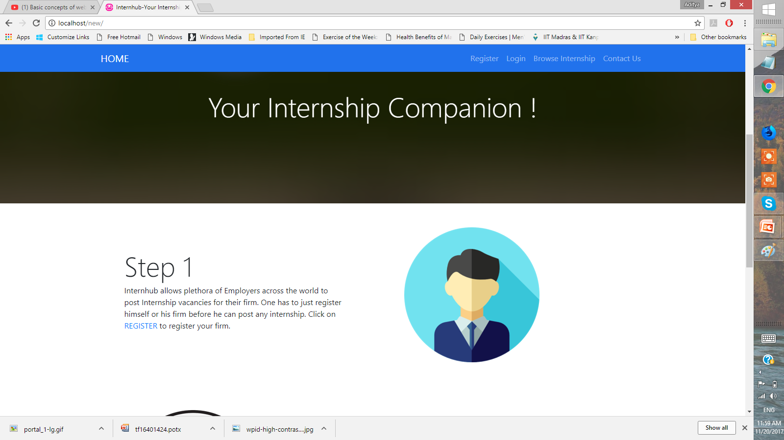
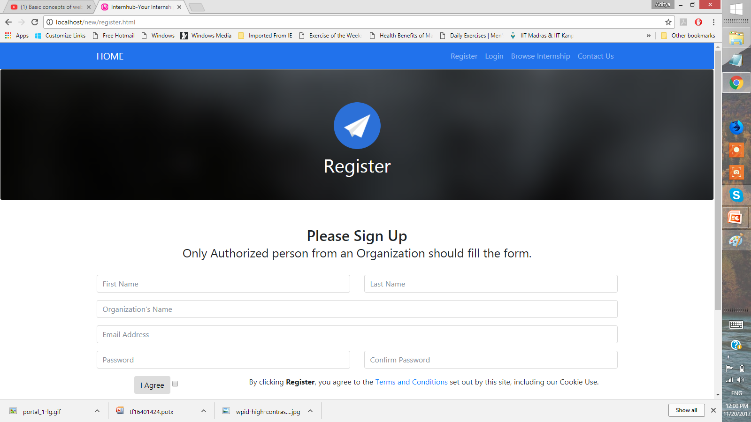
PROJECT AT A GLANCE - Screenshots

Slide 8
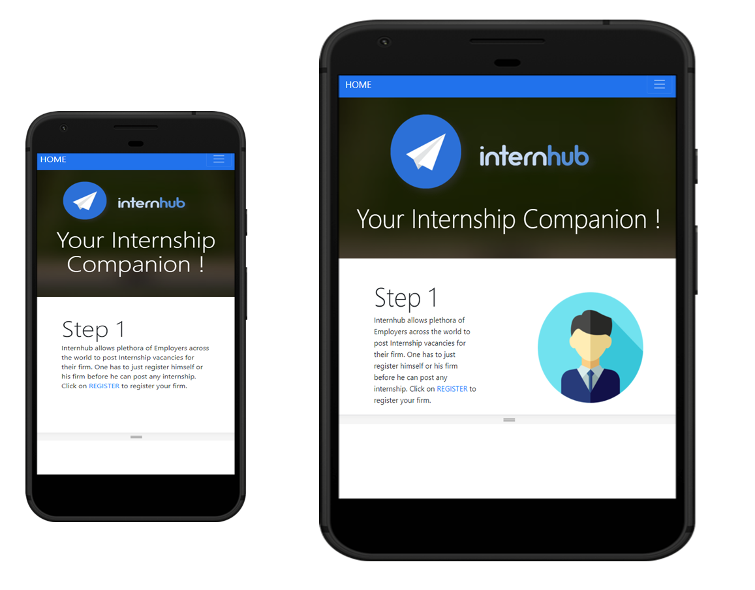
Screenshots
WAMP STACK
PHOTOSHOP
CHROME
ATOM IDE

Slide 9
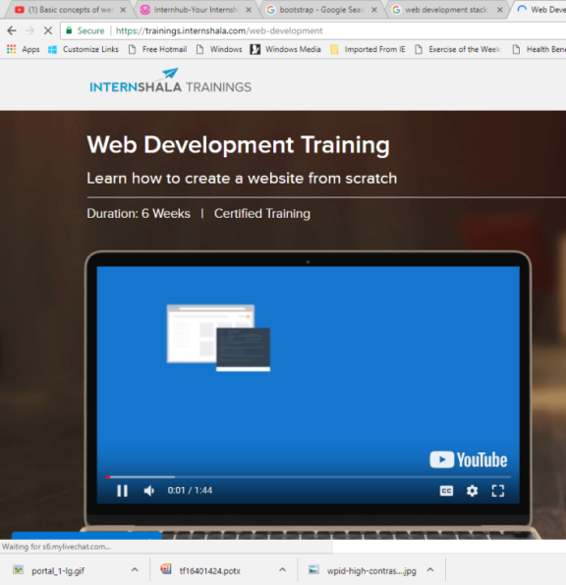




Professional and Technical Learning
BEFORE PROJECT
AFTER PROJECT
Internshala
Training

Slide 10
UI Design
WAMP STACK
Technology Used
HTML
Main Highlights
Materialistic Design
Mobile Responsive
Problems Faced
Designed UI thrice before getting to the final output.
Editing Template got tougher when kickstart HTML elements included.
CSS
KickStart HTML
Used Bootstrap Templates
PHOTOSHOP
CHROME
ATOM IDE

Slide 11
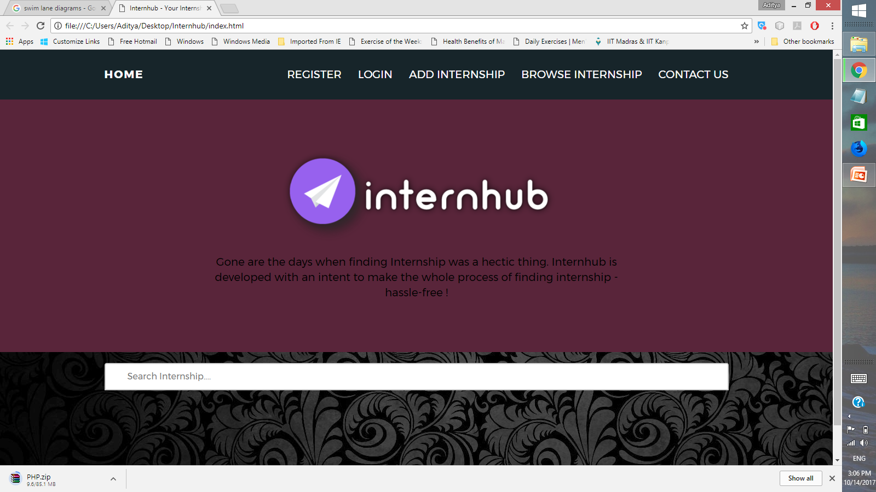
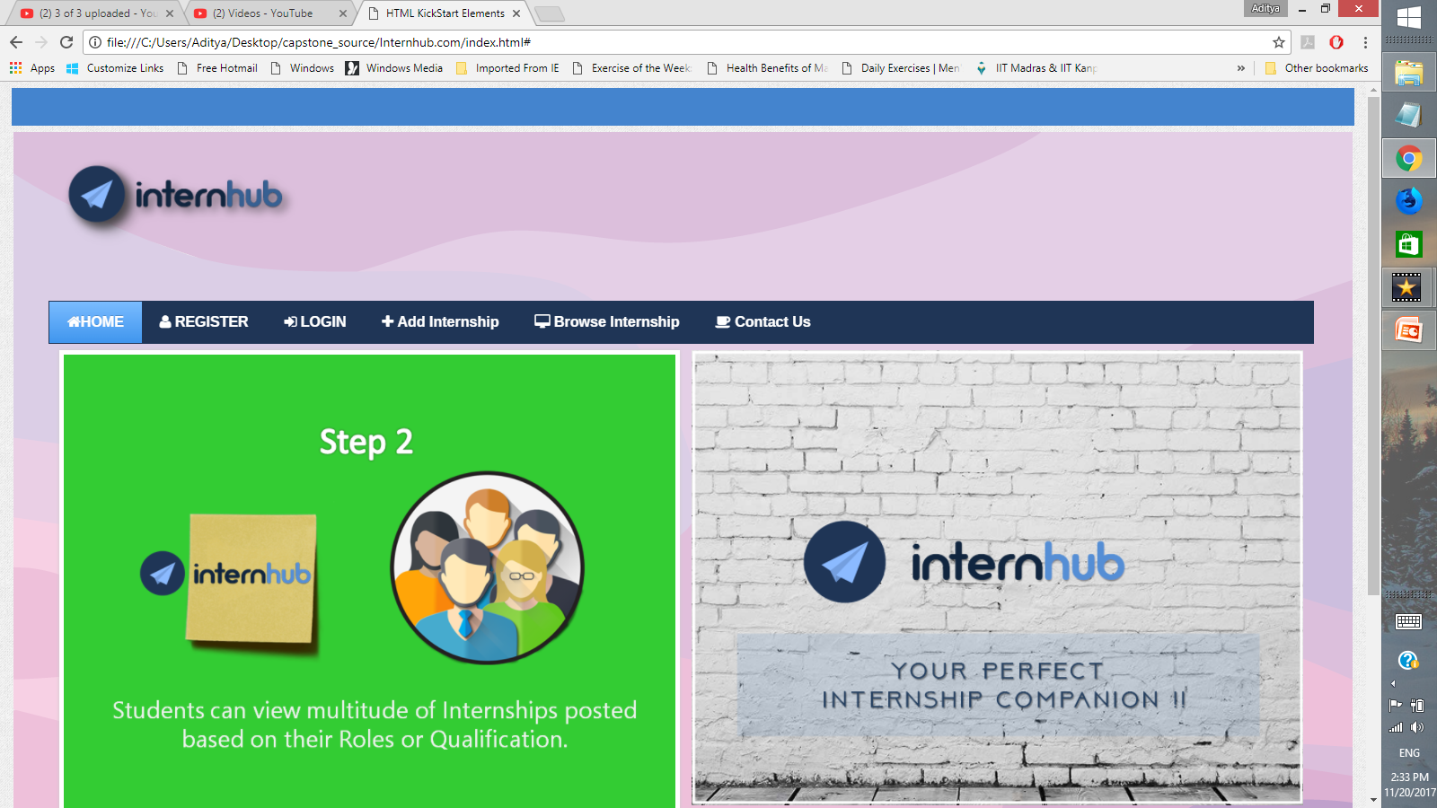
UI DESIGNS
WAMP STACK
PHOTOSHOP
CHROME
ATOM IDE

Slide 12
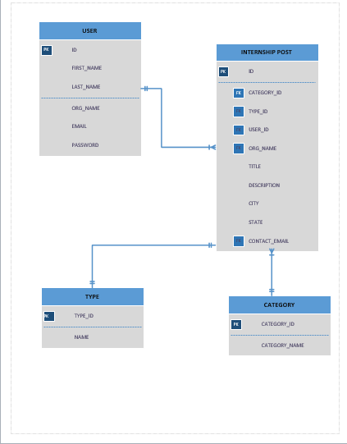
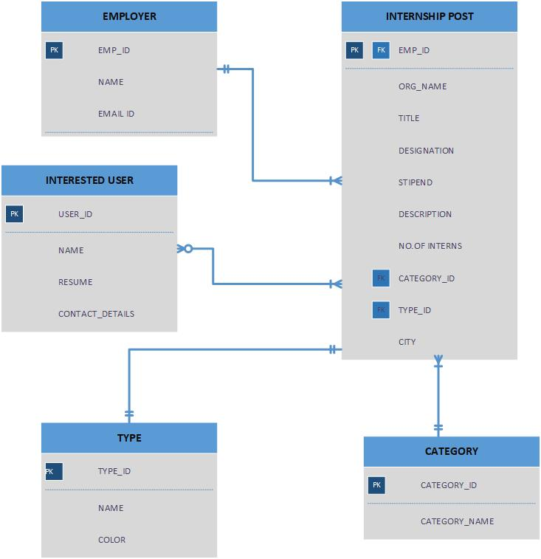
Database
WAMP STACK
Technology Used
MySQLi
Main Highlights
Uploaded using csv files
Problems Faced
Abundant Foreign Keys
Mysqli uses the advance version of mysql.
it Database driver used mainly with php programming lang.
Provides an interface to the already founded mysql database.
Backed up the whole database
Color Code Removal
Number of Tables reduction.
Problem with the nature of database.
PHOTOSHOP
CHROME
ATOM IDE

Slide 13
Linking
WAMP STACK
Technology Used
PHP
Main Highlights
Safe from SQL Injections.
Problems Faced
Mail() function
Light coded (used snippets mostly)
Inline CSS is used in minimal
Fetching Data.
Constraint Restriction.
Less Secured Code
Use of Sessions
Use of Post
PHOTOSHOP
CHROME
ATOM IDE

Slide 14
Key Highlights
Internhub will revamp the Internship Experience. In future, this platform could be used for seeking not just Internships but Projects, Cumulative Research Participation.
Also, we promise to bring a PWA version of our Web Application which will empower the Application on even those systems and mobile phones which aren't that good when it comes to Internet Connectivity.

Slide 15
THANK YOU
https://youtu.be/ROT6c_C1_7I

